Slide 1
BETA 24-25
Montford Middle school

Slide 2
agenda
24-25 Board members
Remind app
expectations
Volunteer hours
beta meetings
Lucky goat fundraiser
Math tutoring
Beta webpage

Slide 3
Congratulations 24-25 Board members Cameron Broder-President Hallie Pearce-Vice President Maci Copelin-Secretary

Slide 4
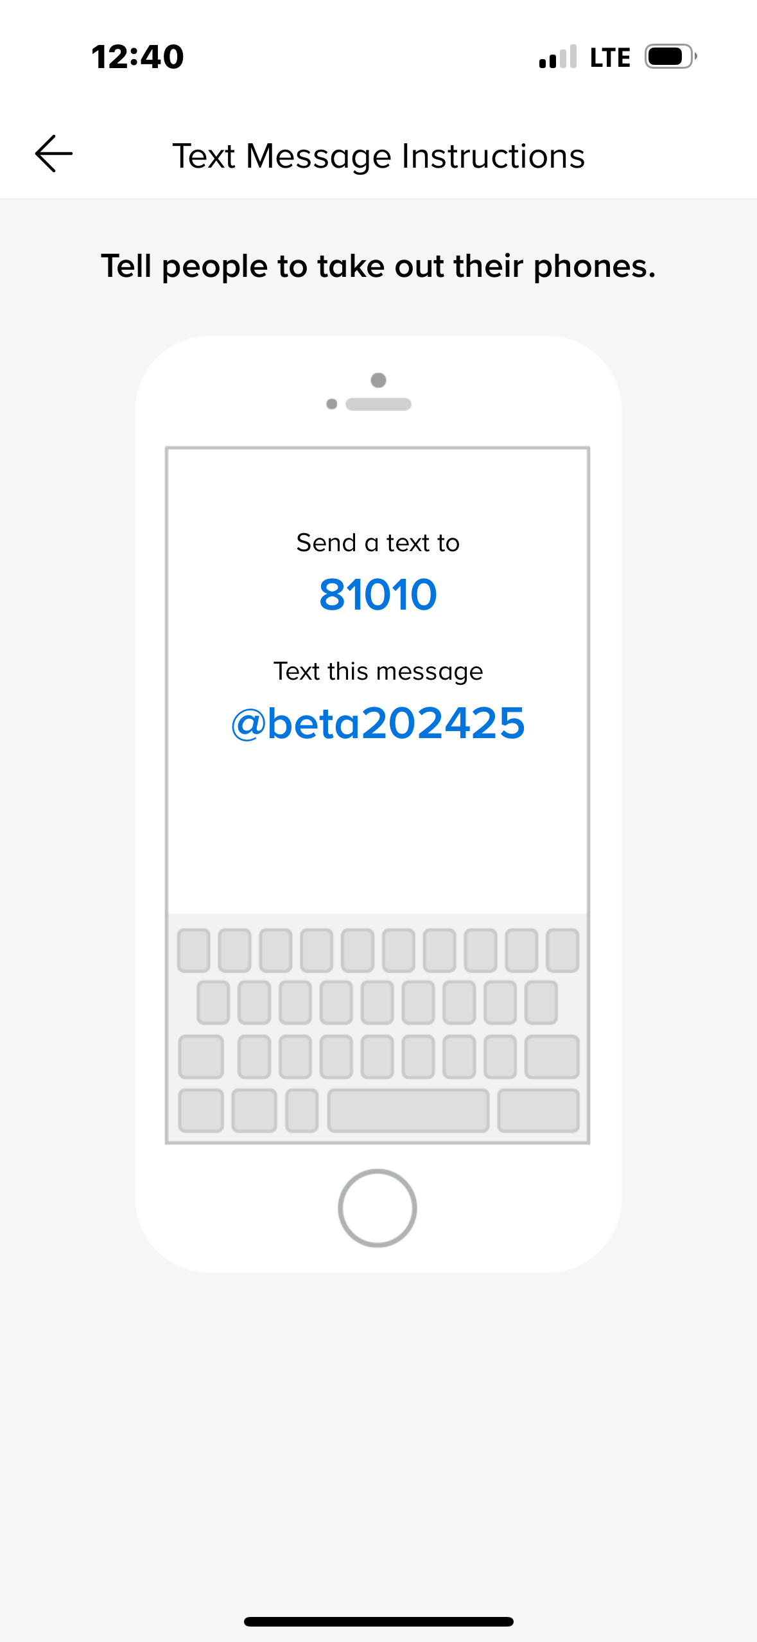
Remind App
Stay informed! It’s your responsibility to do this!
Now open Microsoft Form to
complete attendance.

Slide 5
Expectation of a Beta member
AT least 10 volunteer hours
Attend at least 6 meetings
Excellent citizenship
KEEP UP GRADES – ONLY 1 b ALLOWED
GET INVOLVED IN FUNDRAISERS/SERVICE PROJECTS

Slide 6
BETA WEBPAGE USE IT TO LOOK AT MEETING SCHEDULE USE IT TO FIND VOLUNTEER FORMS use it for meeting attendance

Slide 7
Math tutoring wednesdays
Are you in 8th grade?
Is math your thing?
Are you able to work patiently with others?
Are you good at explaining things?
Then you can earn lots of volunteer hours!
Email loweryd@leonschools.net

Slide 8
Volunteer opportunities
Montford Green Team
Plenty of hours to be made
Contact Ms. Barrett if interested
Concession Stand on 9/30 at 5:45-7:00
Help selling drinks, and food at a basketball game
Contact Ms. Sullivan
First 4 to email her will win! ☺

Slide 9
Lucky Goat Fundraiser All proceeds go to relay for life
Start selling coffee: October 9
Orders Due:
October 23
Pick up your coffee:
November 7

Slide 10
Thank you
It’s going to be a great year of service to others!

